Slide 1
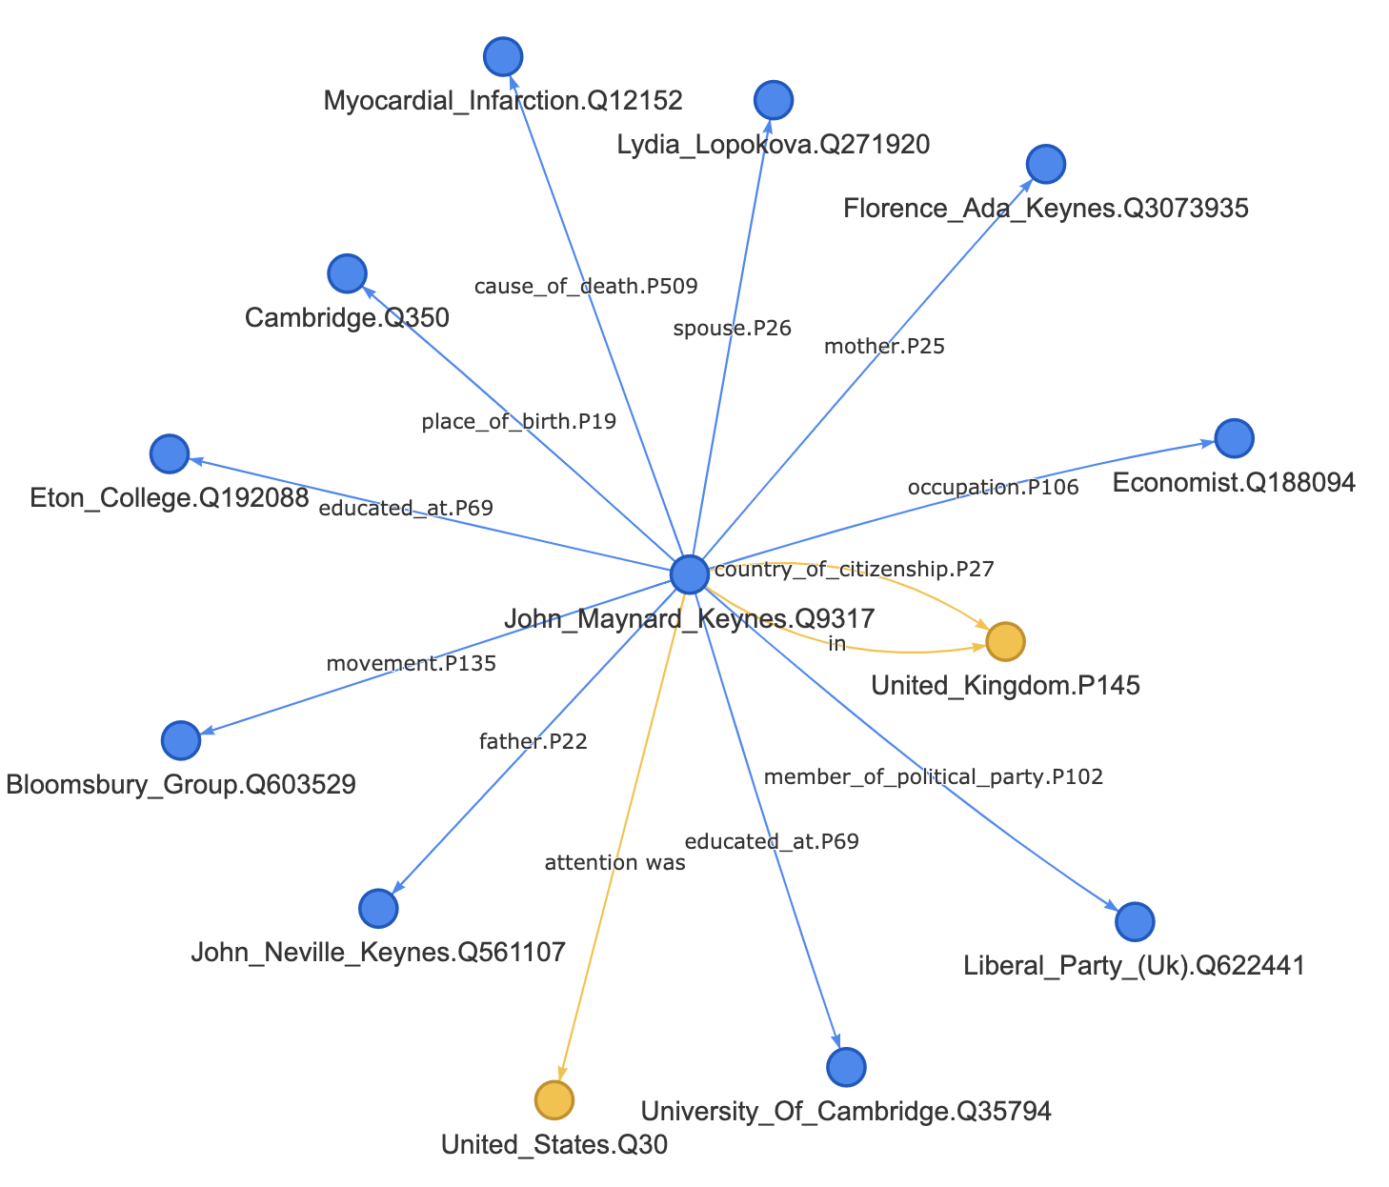
Language Models are Open Knowledge Graphs
Pushpa Yadav (2019900034)
Vijaya Lakhsmi (2018900071)
Karthikeyan Arumugam(2018900074)
Mentor: Tushar Abhishek
CS4.501 Social Computing Spring-2021-Course Project

Slide 2
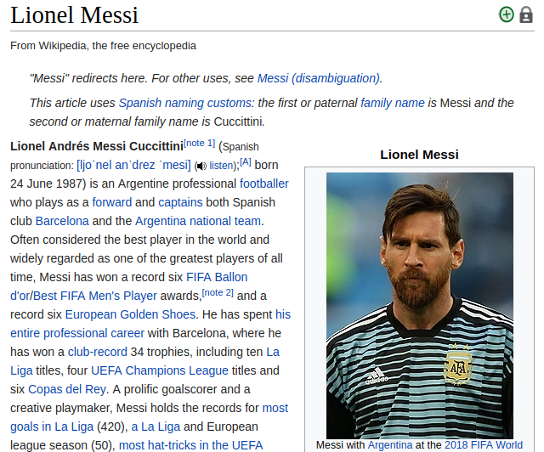
As we can see there are lots of information however there is a slight problem. This is not an ideal source of data to feed to our machines. Not in its current form anyway. We can do it with the help of Knowledge Graphs (KG)
Introduction Of Knowledge Graph
Knowledge Graphs means interconnected entities which can be people, locations, organizations, or even an event.

Slide 3
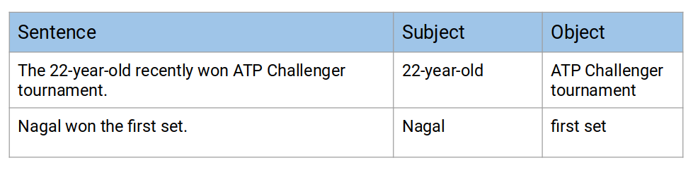
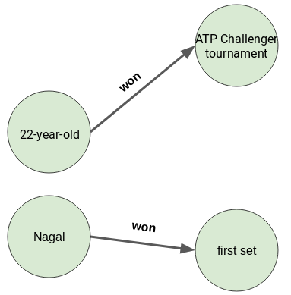
A sample knowledge Graph from text

Slide 4
Literature Survey
“A Survey on Knowledge Graphs” : State of art techniques based on K-BERT,RNN,LSTM-CNN,Bi-LSTM.
“Accurate Text-Enhanced Knowledge Graph Representation Learning” : Framework which enhance the knowledge representations of a triple, and effectively handle the ambiguity of relations and entities through a mutual attention model between relation mentions and entity descriptions.
“Learning to Update Knowledge Graphs from Reading News” : Novel graph based neural network method called GUpdater. Which is build upon graph neural network (GNN) with a text based attention model.
“Collective Multi-type Entity Alignment Between Knowledge Graphs” : Collective Graph neural net work for multi-type entity alignment” (CG-MuAlign). This Model Leverages neighborhood information and generalizes to unlabeled entities types.
“Language Models are Open Knowledge Graphs” : A two-stage unsupervised approach called MaMa (Match and Mapping) , to construct knowledge graphs (KGs) from pre-trained language models (e.g.,BERT, GPT-2/3),

Slide 5
Introduction & Overview of Paper selected
This paper on a high level proposes to construct Knowledge Graphs which is a structured object that's usually built by human experts. It proposes to construct Knowledge Graphs automatically by simply using a pre-trained language model together with a corpus to extract the knowledge graph without human supervision.
In this paper, the authors design an unsupervised approach called MAMA that successfully recovers the factual knowledge stored in Language Models to build Knowledge Graphs from scratch. MAMA constructs a KG with a single forward pass of a pre-trained LM (without fine-tuning) over a textual corpus.

Slide 6
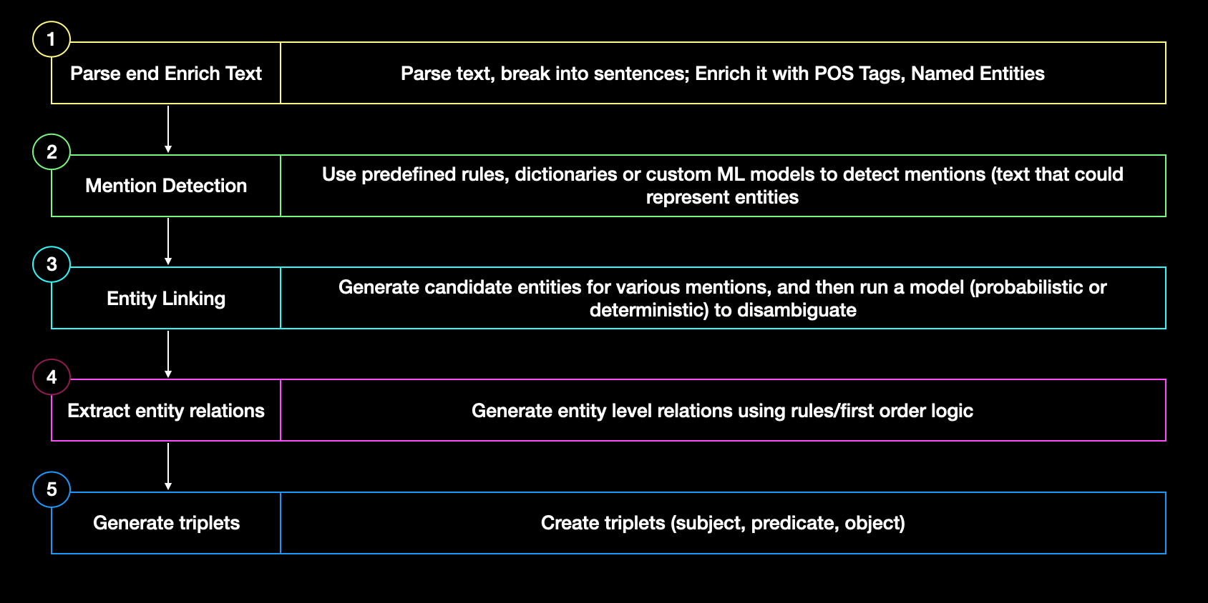
A typical pipeline used to generate triplets for automatic knowledge graph population
The biggest pain point with most of these approaches is the time and effort that they demand from technical specialists who could be data scientists, linguists and knowledge base developers. They need to work closely with domain experts, and come up with raw linguistic features based on enrichments, define domain specific dictionaries and/or first order logic,

Slide 7
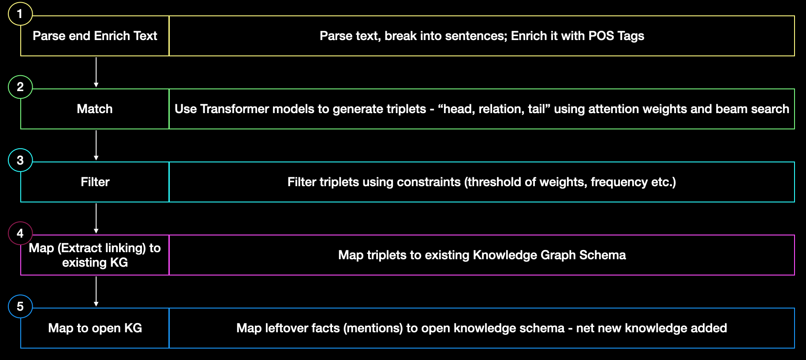
MAMA- Corpus to Knowledge Graph
The Knowledge Graph consists of 2 distinct things, it has entities (you can think of it as nouns) and relations .Here the relations connect to the entities to form meanings.
The Match stage generates a set of candidate facts by matching the facts in the textual corpus with the knowledge in the pre-trained Language Model. Candidate facts are a set of extracted string triplets (namely; head, relation, and tail respectively).
In the Map stage, the candidate facts are mapped to a schema and these schemas are usually defined by humans. So here we’re still going to rely on humans to define the schema. This stage produces an open KG via mapping the matched candidate facts from the Match stage to both fixed KG schema and open schema.

Slide 8
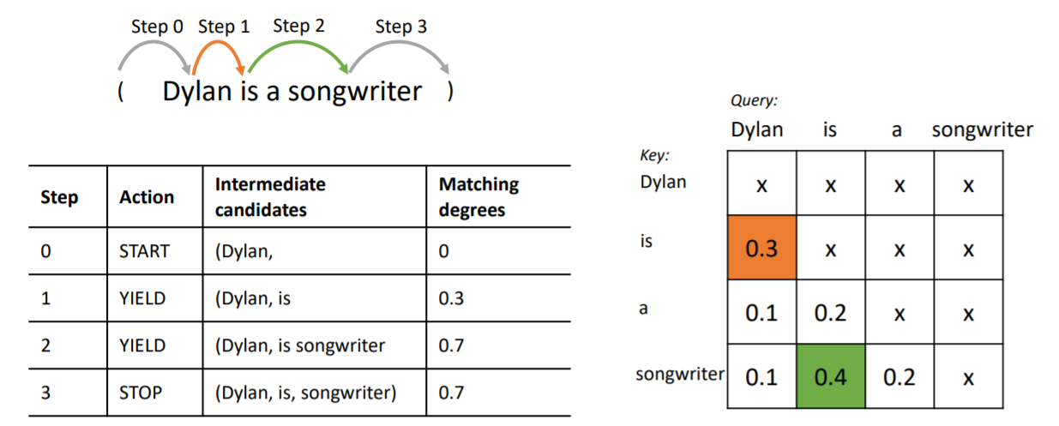
Candidate Fact-Finding Algorithm
There are 3 major steps in the match stage to build a KG from a corpus.
Step 1: Run spaCy to extract noun phrases/chunks. Running the spaCy library through the corpus will find the head and tail of the extracted candidate facts.
Step 2: This is where their system/method comes in. Now we have found the head and tail in the text. Using dynamic programming and search algorithms (Beam search). The algorithm starts from the head of the string (there could be text before it) we’re simply going to locate the head and then we’re going to look at its attention matrix. Now the attention matrix is basically how much each token attends to each other token, i.e, how much information is sent from each other token to a particular token. Since we are locating a relation between the head and the tail, we’re going to disregard all the token behind the query and only look ahead in the sentence.

Slide 9
Constraints while running match
Constraint #1- The matching degree (the sum of all these attention matrix entries that were encountered during the search) must be above some threshold.
Constraint #2- The frequency of r is above a threshold. The relation itself shouldn't be too specific it essentially should appear a bunch of times in the corpus. we go through the corpus once, extract all the candidate facts, and then we count them and go through the candidate facts again and delete all the ones which are below a certain threshold. Similar to the removal of stopwords and rare words.
Constraint #3- Relation r is a contiguous sequence in the sentence.

Slide 10
Mapping Mapped Facts To KG Schema
The goal is to map a candidate fact (h, r, t) to a fact (hk, rk, tk) in the KG schema The reason for mapping to an existing KG schema is to make use of the high-quality schema designed by experts.
Entity linking to KG schema- unsupervised entity linker based on a mention to-entity dictionary (Spitkovsky & Chang, 2012) to link the entities for scalability consideration. Besides, contextual information is crucial to link the entities correctly, we use the word embedding of the context to disambiguate the entities, which means we only link the entities with high contextual similarities based on the word embedding. We adopt the entity linker to map h, t to hk, tk.
Mapping Unmapped Facts to Open Schema
An unmapped candidate fact (h, r, t) means at least one of h, r, and t is not mapped to the KG schema. There are two types of unmapped candidate facts:
Partially unmapped facts- The authors represent at least one of h, r, and t are mapped to the KG schema. It can be h or t mapped to hk or tk based on the entity linker. It can also be r that mapped to rk using the relation mapping. This actually results in unmapped facts that are in a mixture of the KG schema and the open schema.
Completely unmapped facts- The authors indicate all h, r, and t are not mapped to the KG schema. This means neither the entity linker nor the relation mapping is able to map h, r, and t to hk, rk, tk respectively. The resulting unmapped candidate facts stay in the open schema.

Slide 11
Challenges
Limitations
Source Text Cleanups
Coreference Resolution
Invalid - Noisy Triplets
Resolving Generated Entity text and Mapping to Entity ID in WikiData
Resolving - Disambiguating Relations with WikiData
Entity linking library Stanford IE ,REL ,Solution : Spacy Entity Linker
Map to wiki-data entities
Not here to replace existing WikiData processes
- Aids and simplifies the process
Unsupervised - Fact check on content generated from source text is a challenge –
- Confidence Score Approach to aid

Slide 12
Conclusion
It is encouraging to see that language models can be used to extract candidate facts from text, but we observed in the experiments, it is equally important for the data scientist/NLP expert to get the rest of the pipeline tuned to the use case.
Getting the right “knowledge” out depends heavily on a lot more factors beyond plugging in a pre-trained LM like: Identifying the right anchor terms (noun chunks ,named entities etc.)
Reference to Original Paper: Link

Slide 13
References
A Survey on Knowledge Graphs: Representation, Acquisition and Applications , Shaoxiong Ji, Shirui Pan, Erik Cambria, Pekka Marttinen, Philip.S. Yu, 2020 , arXiv:2002.00388 [cs.CL]
“Accurate Text-Enhanced Knowledge Graph Representation Learning”,Bo An, Bo Chen, Xianpei Han and Le Sun,2018, ”Proceedings of the 2018 Conference of the North American Chapter of the Association for Computational Linguistics: Human Language Technologies, Volume 1 ,https://www.aclweb.org/anthology/N18-1068,10.18653/v1/N18-1068
“Learning to Update Knowledge Graphs from Reading News, Jizhi Tang, Yansong Feng, Dongyan Zhao , Proceedings of the 2019 Conference on Empirical Methods in Natural Language Processing and the 9th International Joint Conference on Natural Language Processing (EMNLP-IJCNLP) https://www.aclweb.org/anthology/D19-1265, 10.18653/v1/D19-1265
“ Collective Multi-type Entity Alignment Between Knowledge Graphs, Qi Zhu , Hao Wei, Bunyamin Sisman, Da Zheng , Christos Faloutsos, Xin Luna Dong , Jiawei Han,2020, Proceedings of The Web Conference 2020, https://assets.amazon.science/ff/7a/b96282984a0fbe5e31a8fcf68d17/scipub1202.pdf, https://doi.org/10.1145/3366423.3380289
“ Language Models are Open Knowledge Graphs , Chenguang Wang, Xiao Liu, Dawn Song , 2020, arXiv:2010.11967

